Slide 1
Project Report
Different Stages of Maturity Detection of Oyster
Mushrooms Growing Indoor Chambers
Prof.Dr. Benjamin Leiding
12-01-2023
Notes:
Hello this project was done as part of literarure review of my master thesis. Oyster mushrooms the gourmet mushroom that is growing in the lab in Digit. Where cameras where attached to observe the growth of the Oyster Mushrooms moreover uploaded to TU Clasuthal Cloud. The experimental set up is set up in Goslar DIGIt lab.

Slide 2
Road Map
Introduction
Experimental setup
Related studies
Image Analysis – ML/DL algorithms
Conclusion

Slide 3
Introduction
As the future is vertical farming for a sustainable circular economy aiming for profitable framing an experimental setup was built in the Digit lab, Goslar.[1][2]
Two chambers were arranged in a controlled environment for the optimal growth of Oyster mushrooms where temperature and humidity are controlled. Moreover, cameras were fixed to observe the growth of the Oyster mushrooms

Slide 4
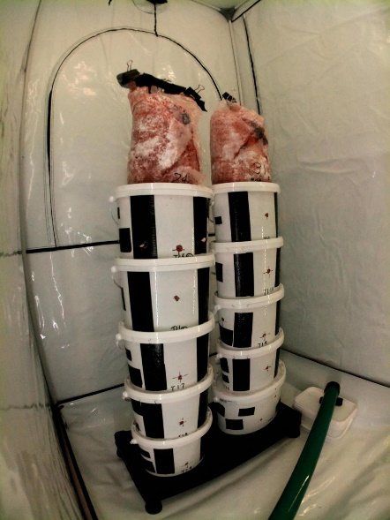
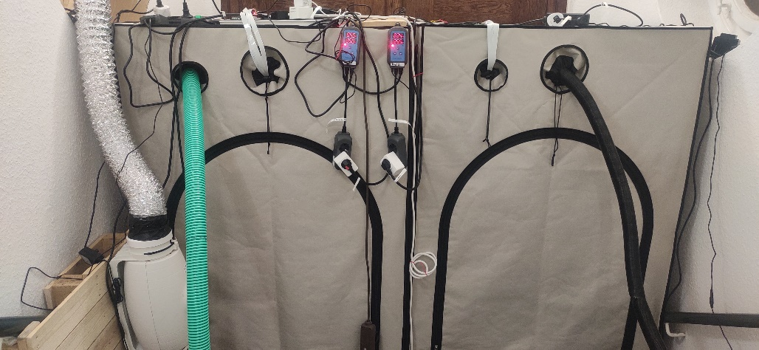
Experimental set up
Growth chamber of Oyster Mushroom in a controlled environment
(a) Indoor grow chambers
(b) Mushroom substrate stack

Slide 5
Procedure of development of Mushroom
Inoculate the substrate for 10 to 15 days and transferred it to the plastic bags/buckets for colonization
After complete colonization of the bag or buckets, i.e. the full white block they were kept in for fruiting in the chambers with a suitably controlled growing environment
Proper cuts or holes are made for fruiting (popping out of the mushrooms)
Uncolonized mycelium is considered contaminated.

Slide 6
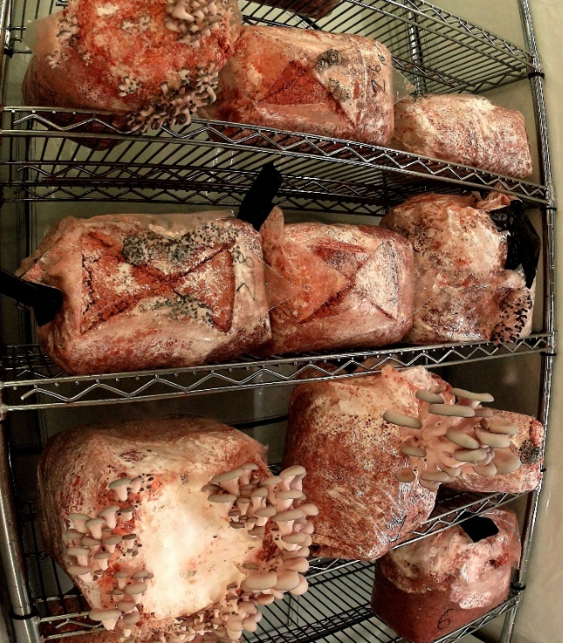
Making of Mushroom pods
Oyster Mushroom pods
inside the growth chamber stacked
replica to vertical farming as it saves space
A sample image from one of the cameras fixed inside the chambers before labelling.

Slide 7
Search Strings Used
Quality classification of edible mushrooms
Methods to classify mushrooms
Harvest time of mushroom
Identification of maturity of oyster mushrooms
Oyster mushroom maturity identification using deep learning
Instance segmentation for oyster mushroom classification
Image analysis of mushrooms
Segmentation for oyster mushroom classification

Slide 8
Selection Criteria
The title, abstract introduction and conclusion of papers [3] to[6] were observed and added to the final stage of deriving the answer to the research question.

Slide 9
Deep Learning and ML algorithms
As the literature review where done , Deep Learning and Machine Learning algorithms are used to identify the object from the picture moreover classify them to categories.
Deep Learning algorithms is a branch of machine learning where takes any kind of complex algorithms and detect the objects, voice, text etc and analysis it.

Slide 10
CNN-VGG16
Grey Oyster Mushroom Classification toward a Smart Mushroom Grading System for Agricultural Factory [3]
Algorithms:- CNN, convolutional neural network large kernel net is used so that the image classification is better in greyscale.
VGG16- the pre-trained network is used and intra-classification of grey oyster mushrooms is done. VGG is a specific CNN that is particularly designed for the localization and classification of objects in the picture.

Slide 11
Single Shot Multi Box Detector-SSD
A Field-Tested Harvesting Robot for Oyster Mushrooms in Greenhouse [4]
Real-time detection and localization using SSD method for oyster mushroom picking robot [5]
The Oyster mushroom growing in the pods is detected using the algorithm SSD and analyzed the maturity.
The position of the mushroom is detected by the bounding box. The presence of the mushroom inside the bounding box is calculated.
When the bounding box overlaps with the highest degree of other bounding boxes, it results in object prediction (accurately)and its location.

Slide 12
YOLO v5
Recursive-YOLO-v5 Network for Edible Mushroom Detection in Scenes With Vertical Stick Placement [6]
Deep learning-based research on the quality classification of Shiitake Mushroom [7]
Compared to other DL algorithms, the YOLO gives rapid and accurte identification of algorithms and outperforms the other DL algorithms in terms of identification.
The efficiency and growth status were calculated. The surface texture of the shiitake mushrooms is correctly observed.

Slide 13
DL Algorithms for object detection and localization
SSD , YOLO,CNN - VGG-16 , R-CNN are the best algorithms for object detection as they outperform the other deep learning algorithms when considering the accuracy and minimum error rate

Slide 14
Conclusion
Proceeding with YOLOv5, SSD, and VGG-16 being some of the best methods to analyse the image and detect the object in the picture which can be used to detect the oyster mushroom in this study.

Slide 15
References
[1] Mohd Salim Mir, Nasir Bashir Naikoo, Raihana Habib Kanth, et al. \Vertical farming: The future of agriculture: A review". In: The Pharma Innovation Journal (2022), pp. 1175{1195}.
[2] ETCE official website. Accessed:2023-01-01. url: https://etce- lab.com/.
[3] Nik Mohd Zarie Hashim, Muhammad Danish Shaharudin, Anuar Jaafar, et al. \Grey Oyster Mushroom Classification toward a Smart Mushroom Grading System for Agricultural Factory". In: 2022 2nd International Conference on Intelligent Technologies (CONIT). IEEE. 2022, pp.16.
[4]Jiacheng Rong, Pengbo Wang, Qian Yang, et al. \A field-tested harvesting robot for oyster mushroom in the greenhouse". In: Agronomy 11.6 (2021), p. 1210.
[5]Yang Qian, Rong Jiacheng, Wang Pengbo, et al. \Real-time detection and localization using SSD method for oyster mushroom picking robot". In: 2020 IEEE International Conference on Real-time Computing and Robotics (RCAR). IEEE. 2020, pp. 158-163.
[6]Bohan Wei, Yao Zhang, Yufan Pu, et al. \Recursive-YOLOv5 Network for Edible Mushroom Detection in Scenes With Vertical Stick Placement". In: IEEE Access 10 (2022), pp. 40093 - 40108.
[7]Qiang Liu, Ming Fang, Yusheng Li, et al. \Deep learning based research on quality classification of shiitake mushrooms". In: LWT 168 (2022), p. 113902.

Slide 16
Thank you

